Slide 1
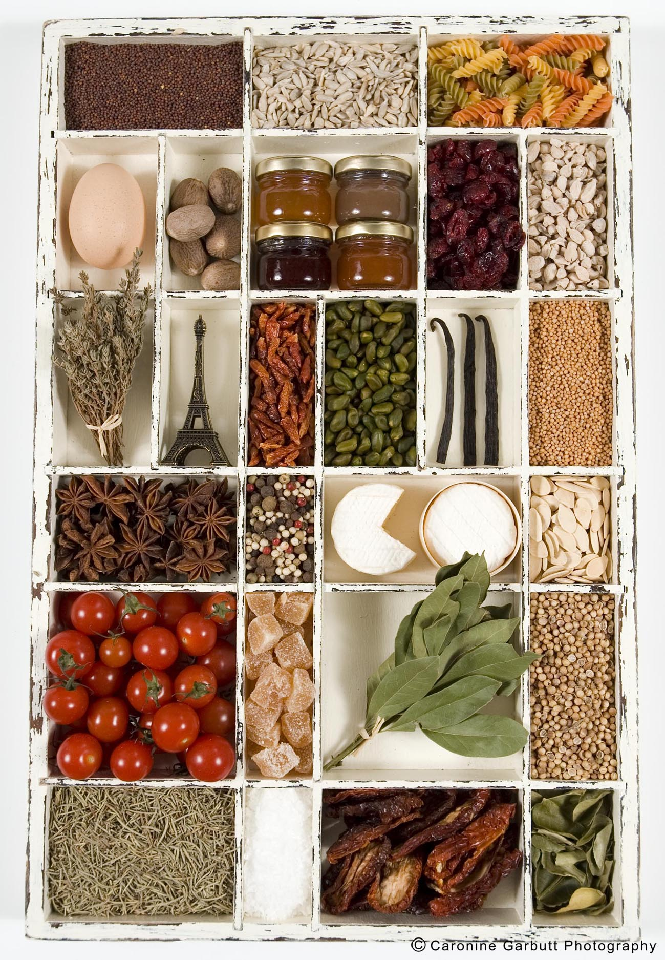
Technology and Food
Team Aristotle:
Osasu Oronsaye: What is Food?
ZefrenEdior: What is Food?
Freddie Amadi: Food Processing
Gabby Macklin: Sub Categories of Food Processing
Vanessa Ayala: 3 Column Chart
Monique DeBarry: What is Food Politics?
Brianne Baird: Affects on Food Politics

Slide 2
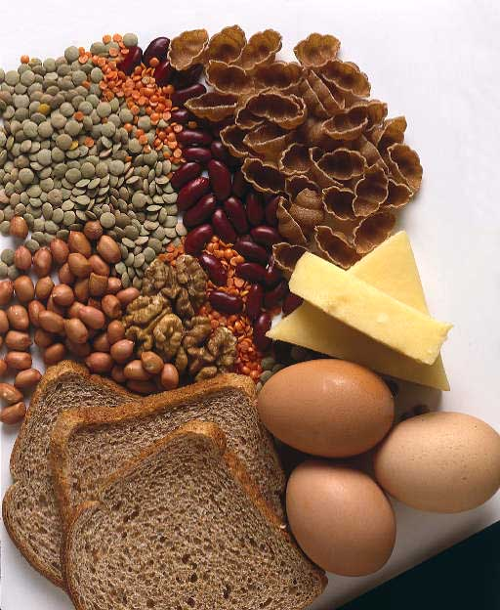
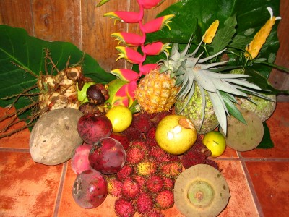
What is Food?
According to Wikipedia food is defined as any substance, usually composed of carbohydrates, fats, proteins and water that can be eaten or drunk by an animal, including humans, for nutrition or pleasure. There are many items that can be considered food.
These foods include plants, animals or other categories such as fungus or fermented products like alcohol.
Osasu Oronsaye & Zefren Edior

Slide 3
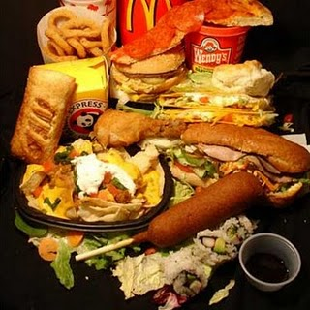

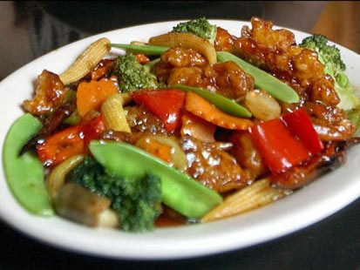
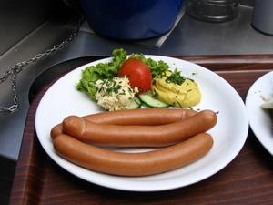
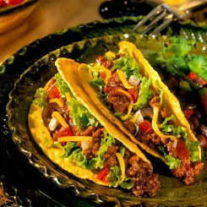
What is Food in different cultures?
Food is represented differently to many diverse cultures.
The idea of food depends on which cultural background the person you speak to comes
from.
Osasu Oronsaye&ZefrenEdior

Slide 4
Foods Grouped According to Biological Source
Group: Animals
Eggs, Milk and Dairy products, Fish, Shellfish, Crustaceans, Ruminants, Monogastric, Avian, Liver, Brain.
Group: Plant
Plants, Vegetables and Fruits.
Group: Insect
Bodies and Products (Honey)
Osasu Oronsaye&
ZefrenEdior

Slide 5
Foods Grouped According to Biological Source
Group: Water
Water- No energy, variable element content.
Group: Soil
Usually a contaminant in food, but deliberately used in cooking by some ethnic groups.
Osasu Oronsaye&ZefrenEdior

Slide 6
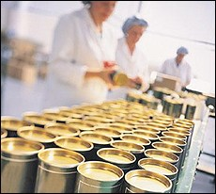
Food Processing
-Food Processing is a set of methods used to transform raw ingredients into food or to transform food into other forms of consumption by people in the food processing industry. There are many different forms of processing, for example the fermentation, milling, controlled storage, packaging, blanching, removal of toxins, freezing are included.
Freddie Amadi

Slide 7
Examples of Food Processing
Fermentation is the transformation from carbohydrates to alcohols or carbon dioxide using bacteria or sometimes even yeasts. It has been known to produce alcoholic beverages such as wine, beer and cider.
-Milling is the grinding of grain so that it can easily be cooked and rendered into different types of foods. Milling can be used for flour, rice, cereal and many other products.
-Controlled Storage is where foods are stored under an atmosphere that differs from air temperature. Its aim is to increase the storage life of the foods. Foods that are most likely processed during this way are fruits and vegetables.
Freddie Amadi

Slide 8
Examples of Food Processing
-Packaging is the enclosing of products for storage and then eventually for sale usage.
-Blanching is the thermal process used mostly for vegetablesit consists of cleaning the product, removing any type of entrapped gases, limping the tissues of vegetables so that they can be easily put in containers and it inactivates enzymes that cause deterioration of foods during frozen storage.
-Removal Of Toxins is where food toxins are removed from different food supplies, in order to prevent food poisoning. One technique they go about doing this is by using the biosensor.
-Freezing is a method of preservation, it slows down decomposition by turning water into ice, which reduces bacterial growth. Due to this technique, foods may be preserved for a number of months.
Freddie Amadi

Slide 9
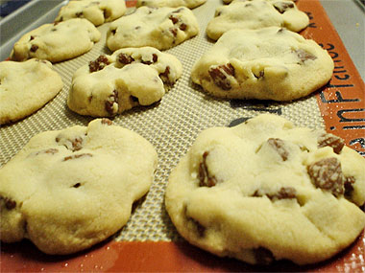
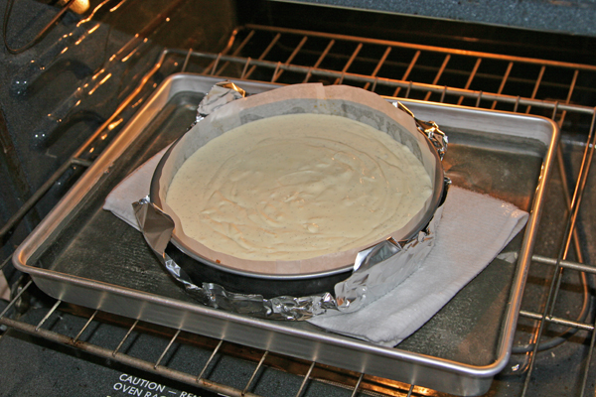
Baking
Gabby Macklin
Baking can be defined as the cooking of food by dry heat in an oven in which the action of the dry convection heat is modified by steam.
Three Methods in Baking
Dry Baking: the most common used, steam rises from the water content of the food; this steam combines with the dry heat of the oven to cook the food, we use this method to bake things like cake and pastries
Increased Humidity Baking: oven humidity is increased by placing a bowl of water or injection steam into the oven
Bain Marie: When you place the food in a container of water to help reduce the heat avoiding the food being burnt or over cooked.

Slide 10
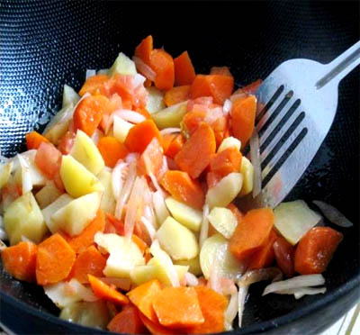
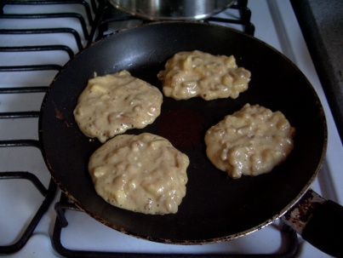
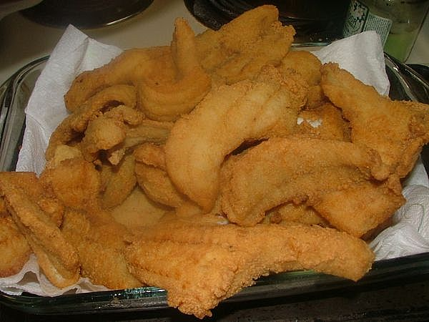
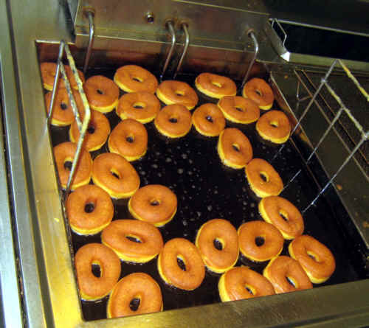
Frying
Gabby Macklin
Shallow Frying
Deep Frying
Cooking food in a small portion of preheated oil inside of a shallow pan or griddle.
-pancakes
-stir fry
-hamburgers
Cooking food in a deep portion of preheated oil inside a deep pan or deep fryer.
Most are coated with flour and milk or eggs an crumb to protect the food from the heat and from drying up.
-most times anything that is covered with a golden brown layer.
-doughnuts, fries, chicken, fish.

Slide 11
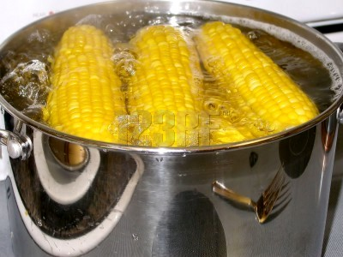
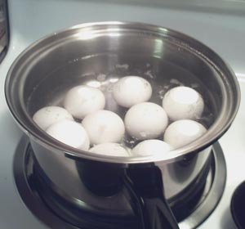
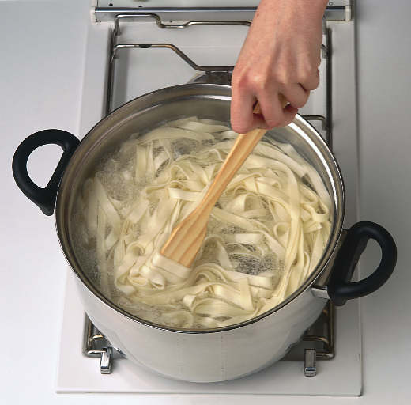
Boiling
Gabby Macklin
Boiling is the cooking of prepared foods in liquid, that can be water, milk or any other liquid cooking product.
-noodles
-veggies
-corn
-eggs
-rice
There are two ways that you can boil
Place food into boiling liquid, then simmer.
You can cover the food in cool liquid first, then boil and after simmer.

Slide 12
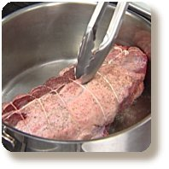
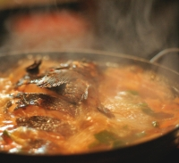
Poaching
Gabby Macklin
Poaching is cooking food in only the amount of liquid needed to cook, and cooking it at a heat just shy of boiling.
Shallow poaching: when foods are cooked in a small amount of liquid and never allowed to boil.
-fish
-chicken
2. Deep poaching: when foods are cooked into enough water to cover the food, sometimes they are brought to a boil then simmered.

Slide 13
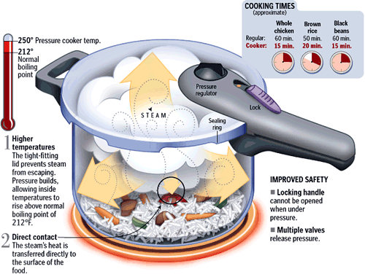
Steaming
Gabby Macklin
Steam cooking is when you are cooking food using the moist heat from the steam under different degrees of heat.
Low pressure steam cooking is when food is cooking in direct or indirect steam
High pressure steam cooking is when food is cooked in equipment built for the purpose of steam cooking, failing to allow the steam to escape from the cooking making the steam pressure build up which increases the temp and cooking time.

Slide 14
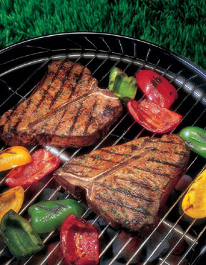
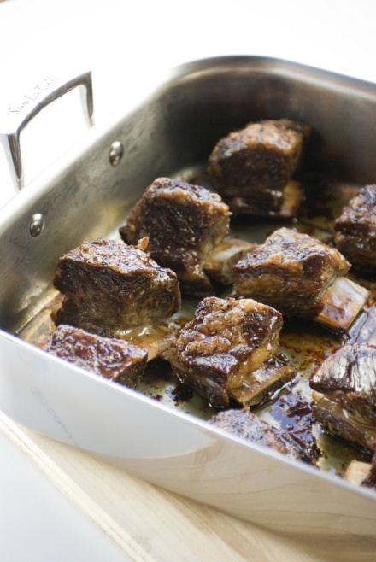
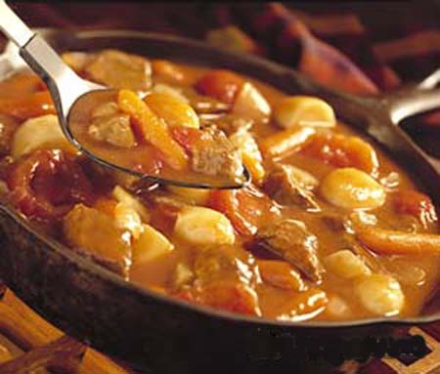
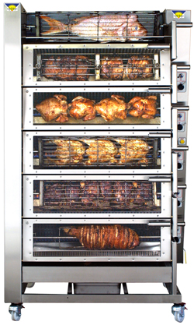
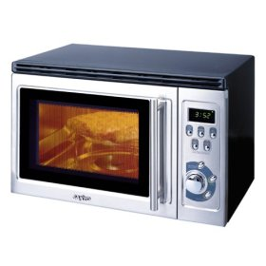
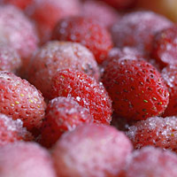
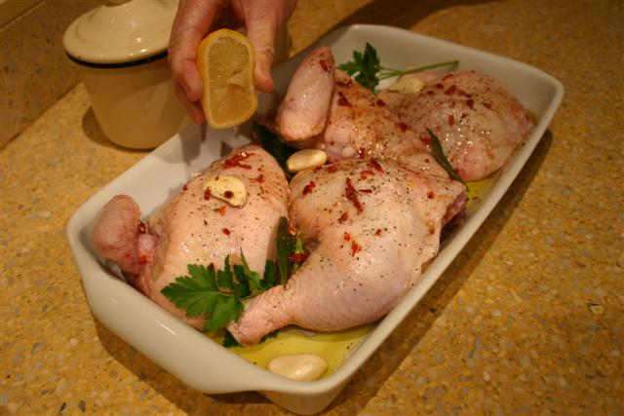
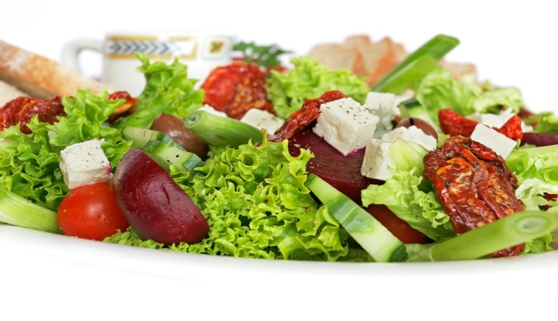
More Sub-Categories
Gabby Macklin
Braising
Grilling
Roasting
Stewing
Microwaving
Freezing/Chilling
Broiling
Marinating
Sautéing
And the method of No cooking.

Slide 15
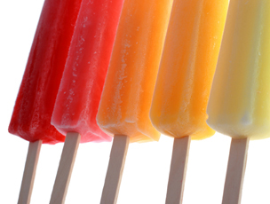
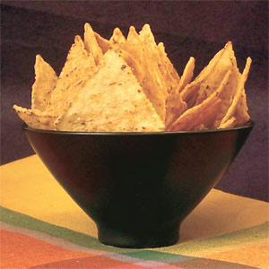
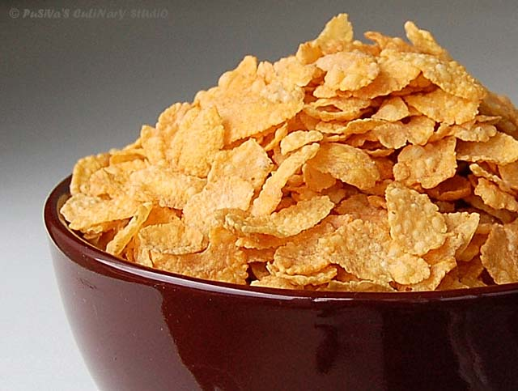
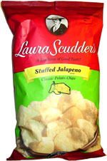
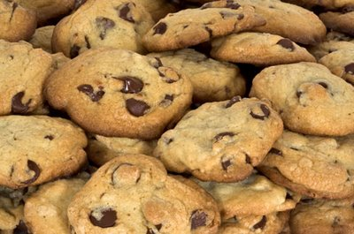
Vanessa Ayala
Food Process Pasteurization | Technology | Inventor
Freezing | Popsicles | Frank Epperson
Canning | Food Preservation Techniques | NicolasApperts
Microbial Growth | Avoids Milk Spoilage | Louis Pasteur
Boiling | Corn Flakes | John Harvey & Will Keith Kellog
Evaporation | Instant Milk Powder | D.D. Peebles
Cooking | Toll House Chocolate Chip Cookies | *Ruth Wakefield
Pickling/ de-bittering method | Olives, Pickles, Peppers | *Martha Laurens Ramsay
Packaging | Potato Chips | *Laura Scudder
Cooking | Nachos | *Carmen Rocha
Refrigeration | Food Products and Safety | *Mary E. Pennington
Frying | Tortilla Chips | Rebecca Webb Carranzaa

Slide 16
Food Politics
Monique DeBarry
What is food politics?
Food politics are the political standpoints of the production, control, regulation, inspection, and distribution of food.
Food Politics are about how the food industry uses tactics such as marketing and advertising, as well as alliances with schools and businesses, to influence what we eat.
Food politics are controversial and have led to many litigations relating to appropriate forms of farming, agricultural, and retailing methods and regulations.
Food politics are affected by roles such as culture, ethics, science, environment, and technology.

Slide 17
How are the Politics of Food Affected by…
Ethics
Culture
Environment
Science
Technology
Brianne Baird

Slide 18
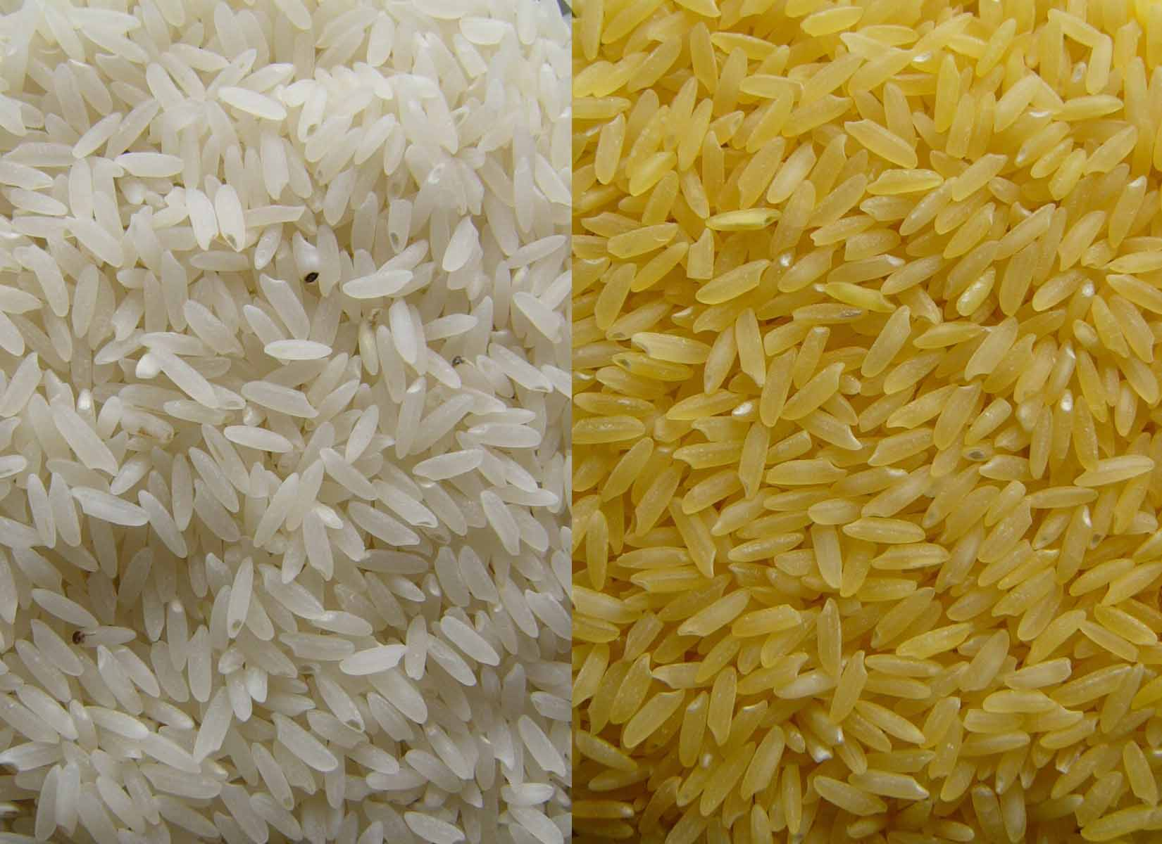
Ethics
Golden/ Orange Rice
Golden rice is genetically engineered rice
Contains high levels of nutrients and vitamins
“Golden Rice offers people in developing countries a valuable and affordable choice in the fight against malnutrition” (goldenrice.org).
Brianne Baird

Slide 19
Ethics
Golden/ Orange Rice
Food Politics
“the project is being criticized for risking lives by feeding humans with a genetically modified crop not yet approved for human consumption” (goldenrice.org).
Is it ethical to give malnourished people genetically engineered food to improve their diets?
A difficult situation to navigate
The stance the food industry takes is torn
An affordable source of nutrition Vs Unnatural genetically modified food awaiting approval for human consumption
Brianne Baird

Slide 20
Culture
Cultural Preference
In The U.S.
Cultural preferences decide who grows, manufactures and packages what types of food
This ranges diversely from regions all over the world
We are tending towards whole, all natural and organic foods
We are dictating what types of foods are being purchased and thus, what types of foods are getting the publicity
Brianne Baird

Slide 21
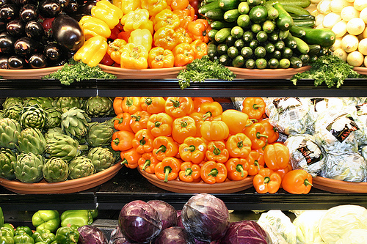
Culture
Preference
Regions are segregated by diversity of food desired and grown
The more desired food generates more wealth for certain areas
Brianne Baird

Slide 22
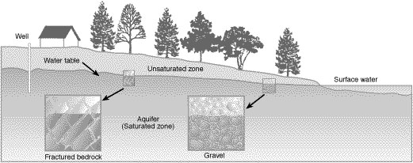
Environment
Environment: Import/ Export
Environment: Contaminants
What crops are imported and exported relies heavily on the environment
Trade restrictions of food are in place on sate to state levels as well as internationally
These can be seen at http://www.fda.gov/Food/InternationalActivities/Imports/default.html
Pesticides if used too often or incorrectly will cause: insect resistance, contaminated water tables, and harm to people and animals (http://extension.missouri.edu)
Most have poisonous effects
Brianne Baird

Slide 23
Environment
Environment: Import/Export
Environment: Contaminants
Food politics deals heavily with importing crops we cannot grow here
If there is a drought, shortage, famine or floods food policies are altered, repealed or created
Ex: Strawberries in California
There are restrictions on who is eligible to use them
PCA Pest Control Advisors are required to give permission to use Class 4 Pesticides
Depending on money of the farmer
Brianne Baird

Slide 24
Science
Plant Breeding
The purpose is to gain more yield
“Plant breeders develop new cultivars having higher yield, earlier maturity, better adaptation, improved quality, and higher resistance to diseases, insects, and environmental stresses” (http://cuke.hort.ncsu.edu)
If more quantity is produced the value goes down
Farmers, Processors, and Distributors are all weary of amounts of crop flooding the market
Brianne Baird

Slide 25
Technology
Genetically Engineered Foods
Different from plant breeding
“plants can be bred by changing their genetic makeup -- often with the insertion of just one gene” (http://www.nytimes.com)
They are Genetically Engineered to be resistant to disease, larger, or more nutritional
The more Genetically Engineered food leads to more laws and restrictions on the growers
Many believe they will be harmful in the long run
The politics of G.E. foods are becoming increasing difficult to navigate
Brianne Baird

Slide 26
Osasu Oronsaye and Zefren Edior’s Bibliography
"Figure3- Foods according to biological source." Healthy Eating Club:Asia Pacific Journal Clinical Nutrition,on-line nutrition course,African food culture. Web. 22 Jan. 2010. <http://www.healthyeatingclub.org/info/books-phds/books/foodfacts/html/maintext/fig3.html>.
"Food -." Wikipedia, the free encyclopedia. Web. 22 Jan. 2010. <http://en.wikipedia.org/wiki/Food>.
"Foods from different cultures." Oracle ThinkQuest Library. Web. 26 Jan. 2010. <http://library.thinkquest.org/J001272F/folklife/recipes/recipes.htm>.

Slide 27
Freddie Amadi’s Bibliography
www.wisegeek.com
www.equipmentsspecialist.com
www.foodproductiondaily.com

Slide 28
Gabby Macklin’s Bibliography
"Baking." The Food Technology Web Site. Media Matters, 1999. Web. 22 Jan. 2010.<http://www.netcomuk.co.uk/~media/bake.htm>
"Boiling." The Food Technology Web Site. Media Matters, 1999. Web. 22 Jan. 2010.<http://www.netcomuk.co.uk/~media/boil.htm>
"Cooking Method." Just The Recipe. Web. 22 Jan. 2010. http://www.justtherecipe.com/>
"Deep Frying." The Food Technology Web Site. Media Matters, 1999. Web. 22 Jan. 2010.<http://www.netcomuk.co.uk/~media/dfry.htm>
"Grilling." The Food Technology Web Site. Media Matters, 1999. Web. 22 Jan. 2010. <http://www.netcomuk.co.uk/~media/grill.htm>.
"Microwaving." The Food Technology Web Site. Media Matters, 1999. Web. 22 Jan. 2010.<http://www.netcomuk.co.uk/~media/micro.htm>
"Poaching." The Food Technology Web Site. Media Matters, 1999. Web. 22 Jan. 2010.<http://www.netcomuk.co.uk/~media/poach.htm>
"Shallow Frying." The Food Technology Web Site. Media Matters, 1999. Web. 22 Jan. 2010.<http://www.netcomuk.co.uk/~media/shfry.htm>

Slide 29
Vanessa Ayala’s Bibliography
"Accidental Eats." csupomona.edu. Cal Poly Pomona, Web. 21 Jan 2010. <http://www.csupomona.edu/~plin/EWS425/food_accidentallyinvented.html>.
"Food techonology." Wikipedia. Web.http://en.wikipedia.org/wiki/Food_technology.
Stanley, Autumn. Mothers and Daughters of Invention: Notes for a Revised History of Technology. Metuchen, NJ: Scarecrow, 1993.
"Women's Inventors; Food Production and Processing." csupomona.edu. Cal Poly Pomona, Web. 21January2010.http://www.csupomona.edu/~plin/inventors/food.html.

Slide 30
Monique DeBarry’s Bibliography
http://en.wikipedia.org/wiki/Food_politics

Slide 31
Brianne Baird’s Bibliography
Fishel, Fred. "Pesticides and the Environment." University of Missouri Extention. Dec. 1999. Web. 18 Jan. 2010. <http://extension.missouri.edu/publications/DisplayPub.aspx?P=G7520>.
"Global Plant Breeding." Global Plant Breeding: Cooperative State REsearch, Education, and Extension Service. Ed. T.C. Wehner. 30 Mar. 2005. Web. 13 Jan. 2010. <http://cuke.hort.ncsu.edu/gpb/>.
"Golden Rice is a Part of the Soultion." Golden Rice. 2009. Web. 20 Jan. 2010. <http://www.goldenrice.org/>.
"Health Genetics: Data." The New York TImes. Web. 20 Jan. 2010. <http://www.nytimes.com/library/national/science/health/gm-index.html>.
"Importing Food Products into the United States." FDA: U.S. Food and Drug Administration. 23 Dec. 2009. Web. 18 Jan. 2010. <http://www.fda.gov/Food/InternationalActivities/Imports/default.htm>.
Pollack, Andrew. "The Green Revolution Yields to the Bottom Line." The New York TImes. 15 May 2001. Web. 20 Jan. 2010. <http://www.nytimes.com/2001/05/15/science/15CROP.html>.

Slide 32
Group Bibliogrpahy
"Accidental Eats." csupomona.edu. Cal Poly Pomona, Web. 21 Jan 2010. <http://www.csupomona.edu/~plin/EWS425/food_accidentallyinvented.html>.
"Baking." The Food Technology Web Site. Media Matters, 1999. Web. 22 Jan. 2010. <http://www.netcomuk.co.uk/~media/bake.htm>
"Boiling." The Food Technology Web Site. Media Matters, 1999. Web. 22 Jan. 2010. <http://www.netcomuk.co.uk/~media/boil.htm>
"Cooking Method." Just The Recipe. Web. 22 Jan. 2010. http://www.justtherecipe.com/>
"Deep Frying." The Food Technology Web Site. Media Matters, 1999. Web. 22 Jan. 2010.<http://www.netcomuk.co.uk/~media/dfry.htm>
"Figure3- Foods according to biological source." Healthy Eating Club:Asia Pacific Journal Clinical Nutrition,on-line nutrition course,African food culture. Web. 22 Jan. 2010. <http://www.healthyeatingclub.org/info/books-phds/books/foodfacts/html/maintext/fig3.html>.
Fishel, Fred. "Pesticides and the Environment." University of Missouri Extention. Dec. 1999. Web. 18 Jan. 2010. <http://extension.missouri.edu/publications/DisplayPub.aspx?P=G7520>.
"Food techonology." Wikipedia. Web. http://en.wikipedia.org/wiki/Food_technology.
"Food -." Wikipedia, the free encyclopedia. Web. 22 Jan. 2010. <http://en.wikipedia.org/wiki/Food>.
"Global Plant Breeding." Global Plant Breeding: Cooperative State REsearch, Education, and Extension Service. Ed. T.C. Wehner. 30 Mar. 2005. Web. 13 Jan. 2010. <http://cuke.hort.ncsu.edu/gpb/>.
"Golden Rice is a Part of the Soultion." Golden Rice. 2009. Web. 20 Jan. 2010. <http://www.goldenrice.org/>.
"Grilling." The Food Technology Web Site. Media Matters, 1999. Web. 22 Jan. 2010. <http://www.netcomuk.co.uk/~media/grill.htm>.
"Health Genetics: Data." The New York TImes. Web. 20 Jan. 2010. <http://www.nytimes.com/library/national/science/health/gm-index.html>.
http://en.wikipedia.org/wiki/Food_politics
"Importing Food Products into the United States." FDA: U.S. Food and Drug Administration. 23 Dec. 2009. Web. 18 Jan. 2010. <http://www.fda.gov/Food/InternationalActivities/Imports/default.htm>.
"Microwaving." The Food Technology Web Site. Media Matters, 1999. Web. 22 Jan. 2010.<http://www.netcomuk.co.uk/~media/micro.htm>

Slide 33
Group Bibliography Continued
Pollack, Andrew. "The Green Revolution Yields to the Bottom Line." The New York TImes. 15 May 2001. Web. 20 Jan. 2010. <http://www.nytimes.com/2001/05/15/science/15CROP.html>.
"Poaching." The Food Technology Web Site. Media Matters, 1999. Web. 22 Jan. 2010. <http://www.netcomuk.co.uk/~media/poach.htm>
"Shallow Frying." The Food Technology Web Site. Media Matters, 1999. Web. 22 Jan. 2010. <http://www.netcomuk.co.uk/~media/shfry.htm>
Stanley, Autumn. Mothers and Daughters of Invention: Notes for a Revised History of Technology. Metuchen, NJ: Scarecrow, 1993.
"Women's Inventors; Food Production and Processing." csupomona.edu. Cal Poly Pomona, Web. 21January2010. http://www.csupomona.edu/~plin/inventors/food.html.
"Foods from different cultures." Oracle ThinkQuest Library. Web. 26 Jan. 2010. <http://library.thinkquest.org/J001272F/folklife/recipes/recipes.htm>.
www.wisegeek.com
www.equipmentsspecialist.com
www.foodproductiondaily.com

